Slide 1
OA & IR,
The University of Hong Kong, & Greater China
David T Palmer
The University of Hong Kong (HKU)
[SPARC Japan]
7 Feb 2014

Slide 2
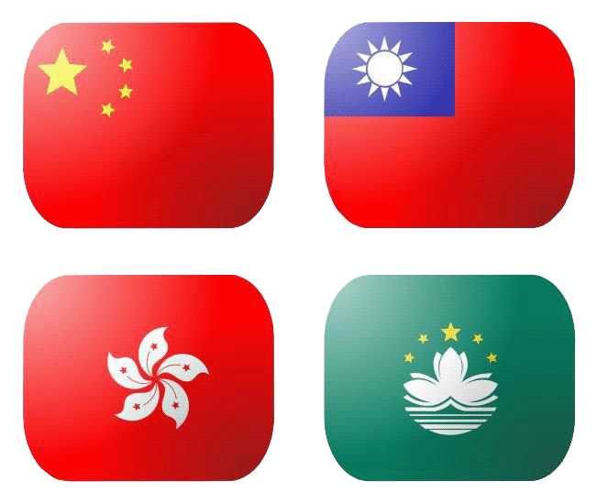
China PRC
1.3bn 人口
Taiwan ROC
23M 人口
Hong Kong SAR
7M 人口
Macao SAR
568k人口

Slide 3
The HKU Scholars Hub
2005 begun
  Publications
  Open Access
Not compelling with faculty
2009 “Knowledge Exchange”
  New funding, from HKU KEO
  New interest, from faculty
An exchange of research and skills between HKU and its community for mutual benefits

Slide 4
The HKU Scholars Hub
2005 begun
  Publications
  Open Access
Not compelling with faculty
2009 “Knowledge Exchange”
  New funding, from HKU KEO
  New interest, from faculty
An exchange of research and skills between HKU and its community for mutual benefits

Slide 5

Knowledge Transfer
knowledge transfer by supporting schemes and activities to transfer good ideas, research results and skills between, for example, universities and other research organisations, business, the third sector, public sector and/or the wider community.
Knowledge Based Economy
  Triple Helix
    University, Industry & Government
The University’s Mission
  Research
  Teaching
  3rd mission of the institution: KT
Image: http://www.tusur.ru/en/enterprise/triple-helix/

Slide 6
Knowledge Transfer
RCUK
University of Melbourne
University of Leeds
等々

Slide 7
“Knowledge Exchange”
-- A co-operative effort
CSC Finland
DEFF Denmark
DFG Germany
JISC UK
SURF The Netherlands
To make a layer of scholarly and scientific content openly available on the Internet.

Slide 8
Canadian Institutes of Health Research (CHIR)
Knowledge Translation
One outcome
  2008 Mandate requiring all peer reviewed research, bioinformatics, atomic, and molecular coordinate data, be available in OA, six months after publication
  http://www.ktdrr.org/ktlibrary/articles_pubs/ncddrwork/focus/focus18/Focus18.pdf

Slide 9
Hong Kong:
University Grants Council (UGC)
Research Grants Council (RGC)
The University of Hong Kong (HKU)
The Chinese University of Hong Kong (CUHK)
The Hong Kong University of Science & Technology (HKUST)
Hong Kong Baptist University (HKBU)
The Hong Kong Polytechnic University (PolyU)
City University of Hong Kong (CityU)
Lingnan University (LU)
The Hong Kong Institute of Education (HKIEd)

Slide 10
HKU: Knowledge Exchange
Faculty of Engineering: Fighting High-Tech Crime in cyberspace
Faculty of Business: Data mining to find new blood donors
Faculty of Law: Creation of a Human Rights Portal
Faculty of Science: Light pollution in Hong Kong
Funding for IR development
Funding for OA experiments

Slide 11
HKU: Knowledge Exchange
Faculty of Engineering: Fighting High-Tech Crime in cyberspace
Faculty of Business: Data mining to find new blood donors
Faculty of Law: Creation of a Human Rights Portal
Faculty of Science: Light pollution in Hong Kong
Funding for IR development
Funding for OA experiments

Slide 12
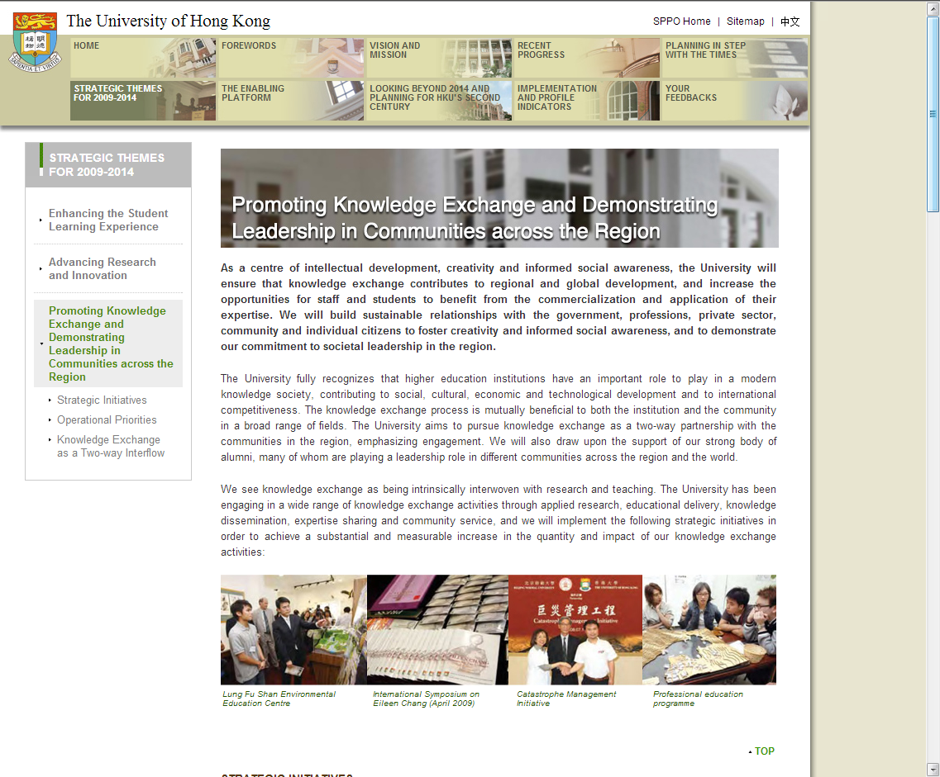

Slide 13
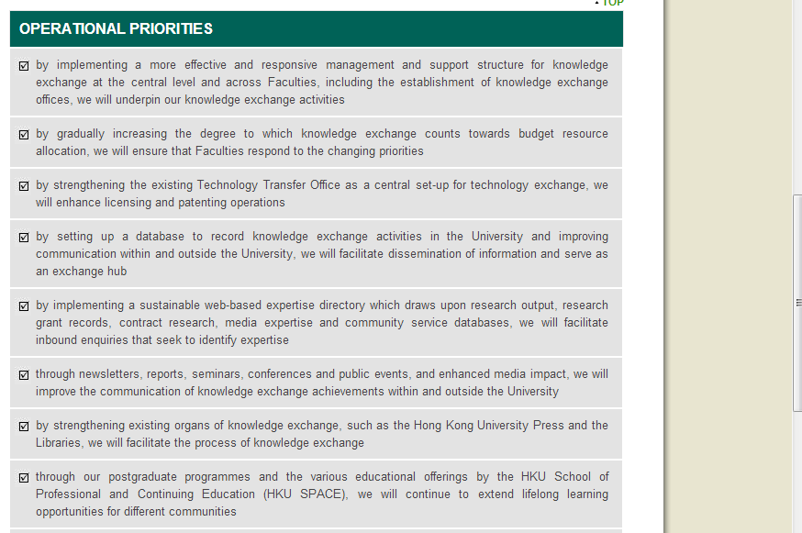

Slide 14
The Hub
IR ➔ Current Research Information System (CRIS)
研究情報管理システム
IR
Publications
Why?
  Provide Open Access
  Create global visibility
  Collect content in a single location
  Preservation
CRIS
Research Information
  People, projects, organizations, results, facilities, equipment, etc.
Why?
  Measurement & analysis of research activity
  Optimization of the funding process
  For the media & public: easy access to research results ➔ Open Access

Slide 15
The Hub
IR ➔ Current Research Information System (CRIS)
研究情報管理システム
IR
Publications
Why?
  Provide Open Access
  Create global visibility
  Collect content in a single location
  Preservation
CRIS
Research Information
  People, projects, organizations, results, facilities, equipment, etc.
Why?
  Measurement & analysis of research activity
  Optimization of the funding process
  For the media & public: easy access to research results ➔ Open Access

Slide 16
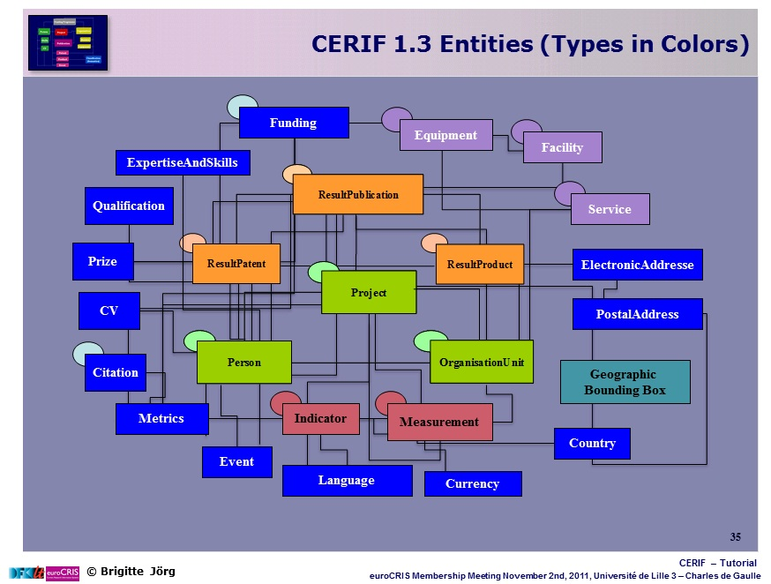

Slide 17
The Backend
With our partners, CINECA of Italy
DSpace: Postgres tables
Relational tables
  Publications
  ResearcherPages (People)
  Grants
  Faculties, Departments & Centres
“Dspace-CRIS”
  http://cilea.github.com/dspace-cris/index.html
EuroCRIS adopted Dspace-CRIS as its official IR
  http://www.duraspace.org/eurocris-adopts-dspace-cris-its-official-institutional-repository

Slide 18
The Backend
With our partners, CINECA of Italy
DSpace: Postgres tables
Relational tables
  Publications
  ResearcherPages (People)
  Grants
  Faculties, Departments & Centres
“Dspace-CRIS”
  http://cilea.github.com/dspace-cris/index.html
EuroCRIS adopted Dspace-CRIS as its official IR
  http://www.duraspace.org/eurocris-adopts-dspace-cris-its-official-institutional-repository

Slide 19
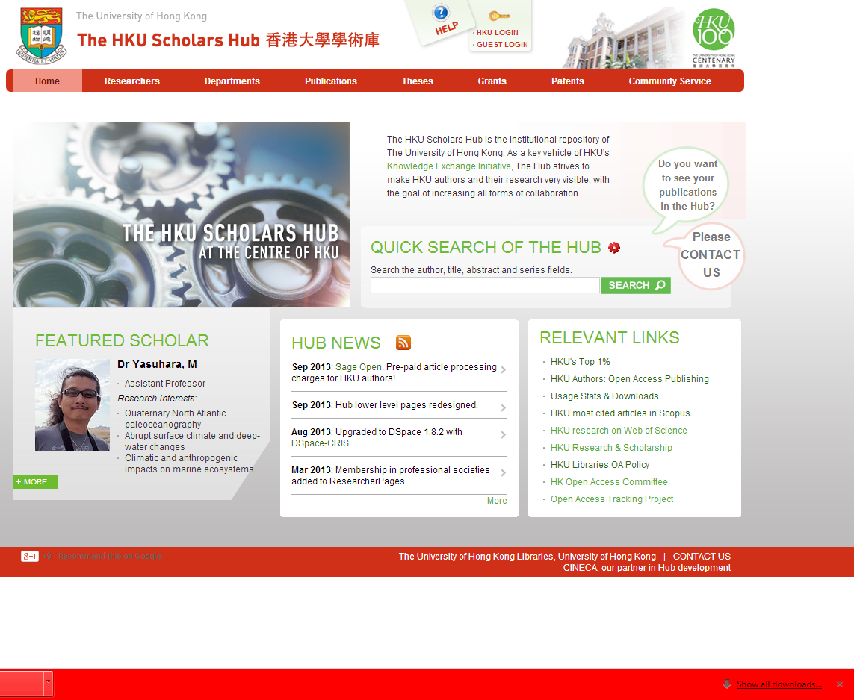
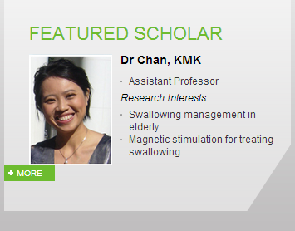
Notes:
ResearcherPages, Publications, Theses, Grants, Patents, Community Service, and soon Depts/Ctrs
Our chosen partner, CINECA of Italy.
Customization
Creation of other relational tables for these other objects and their attributes

Slide 20
Research is more than publications
people
Departments
Grants
Funders
Patents
Equipment
Departments, etc
When all interlinked, and linked to outside sources,
  Contextualizes research
  Many more access points, from which discovery happens

Slide 21
Publications
著作

Slide 22
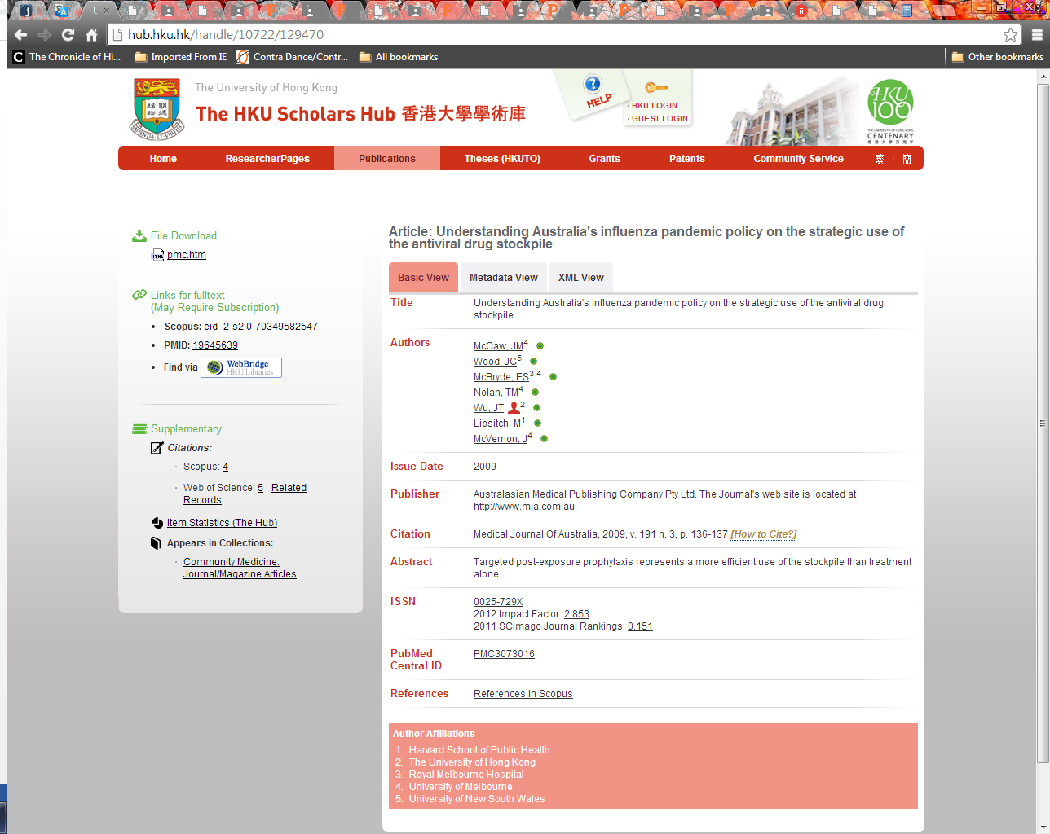
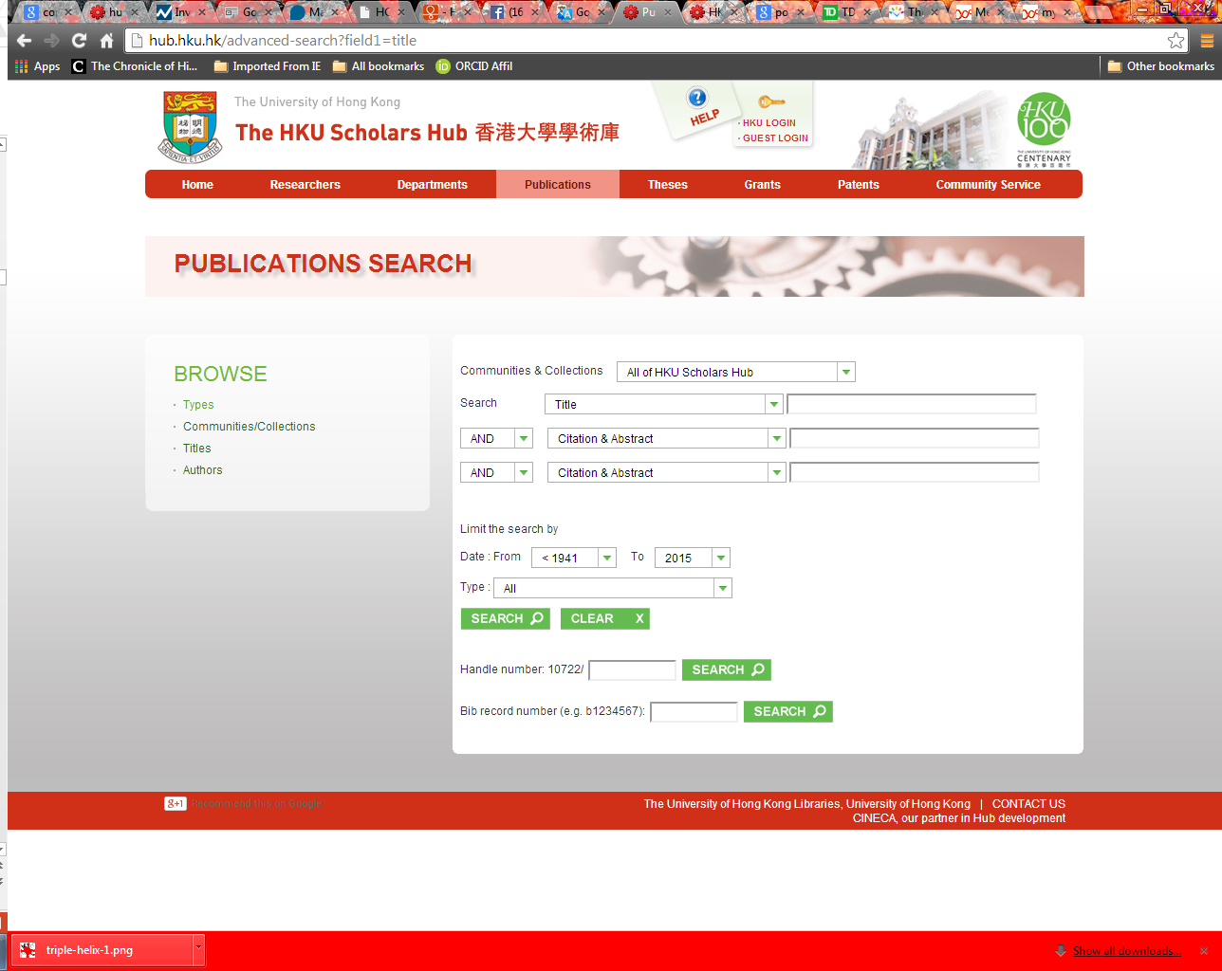
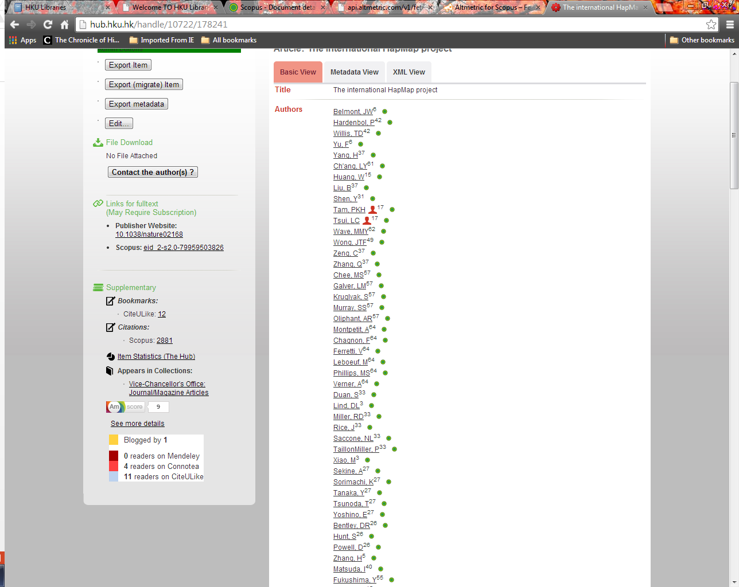

Slide 25
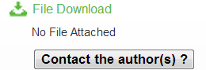
Article Level Metrics
Alt-metrics

Slide 26
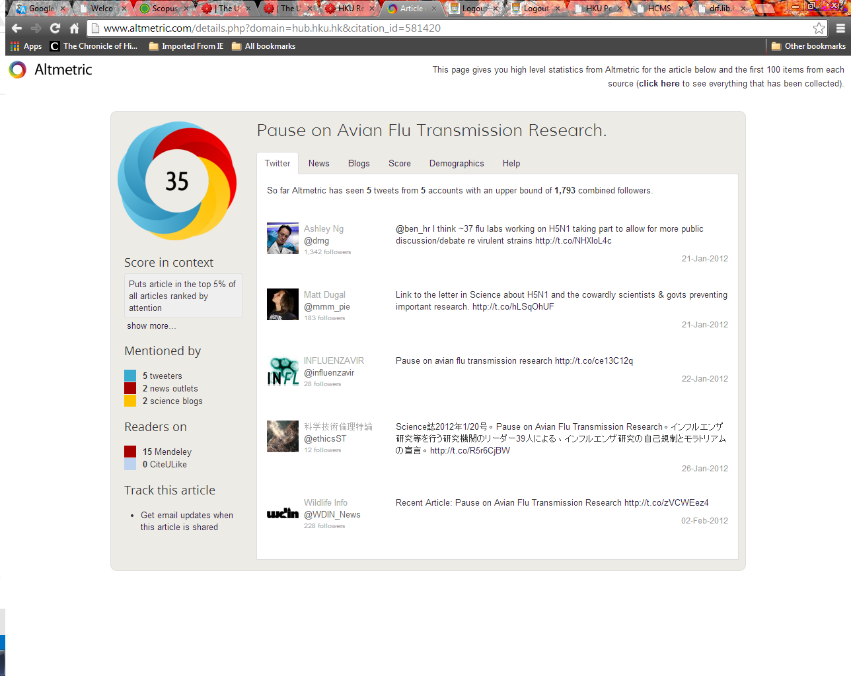

Slide 28
Scopus Links
ORCID links

Slide 29
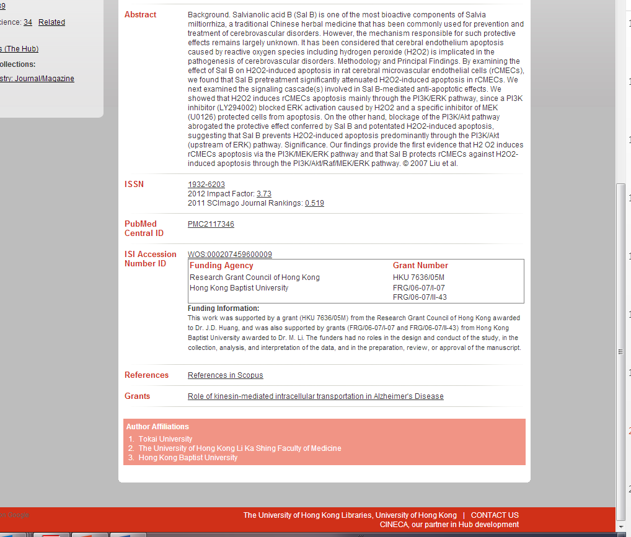
Journal Level Metrics
Notes:
We can click to fulltext in Scopus.
With correct DOI, we can bring in on-the-fly, corresponding citation counts from Scopus, WoS, PubMed Central, etc.
Link to Grants & patents ?
We bring the Impact Factor from TR JCR
Journal level metrics:

Slide 30
Researchers
学者

Slide 31
Owner | Database | Data
HKU Registry | Communications Directory | Name, email, office, title
-- ditto | Research Output System (ROS) | Publications Data
-- ditto | -- ditto | Awards, honours, prizes
HKU Registry, Research Services | Research Committee Grants Application System | Grant, PI, Co-I, panel, keywords, funding, etc.
HKU Graduate School | Postgraduate student supervision DB | Supervised students, thesis title, date, etc.
Faculty, Department pages | Staff profiles | Research interests, picture, etc.
HKU Communications & Public Affairs (CPAO) | Media Contact Directory | Expertise, languages spoken & written
-- ditto | Community Service DB | Editorships, miscellaneous
HKU Tech Transfer Office |  | Patent data

Slide 32
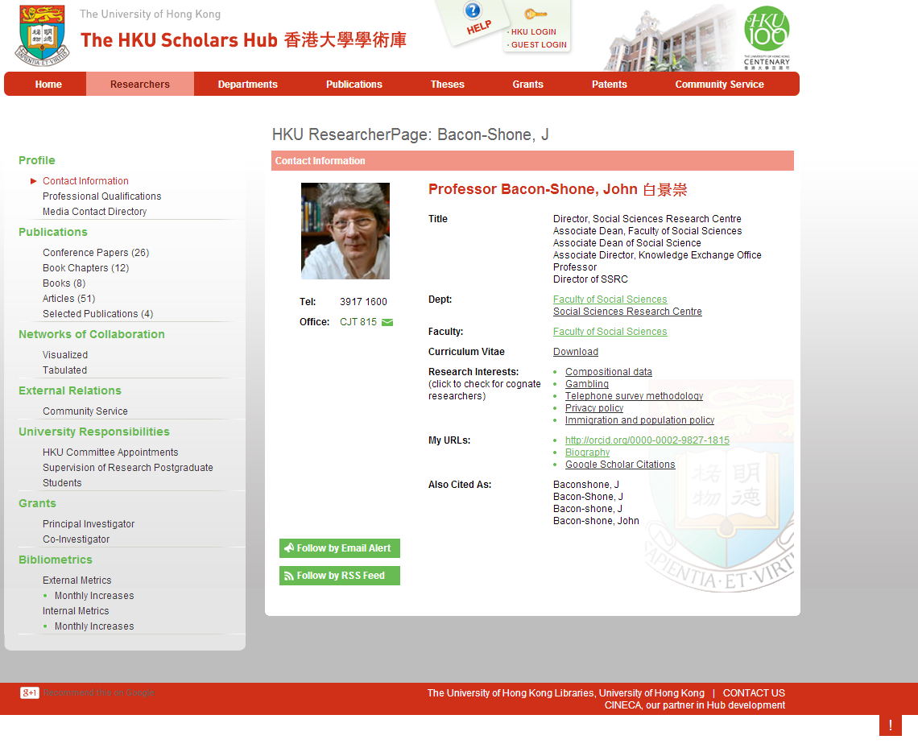
Notes:
On the right, name card, research interests
On the left, publications including thesis, achievements, grants, bibliometrics
Academic can login to edit, mostly hide

Slide 33
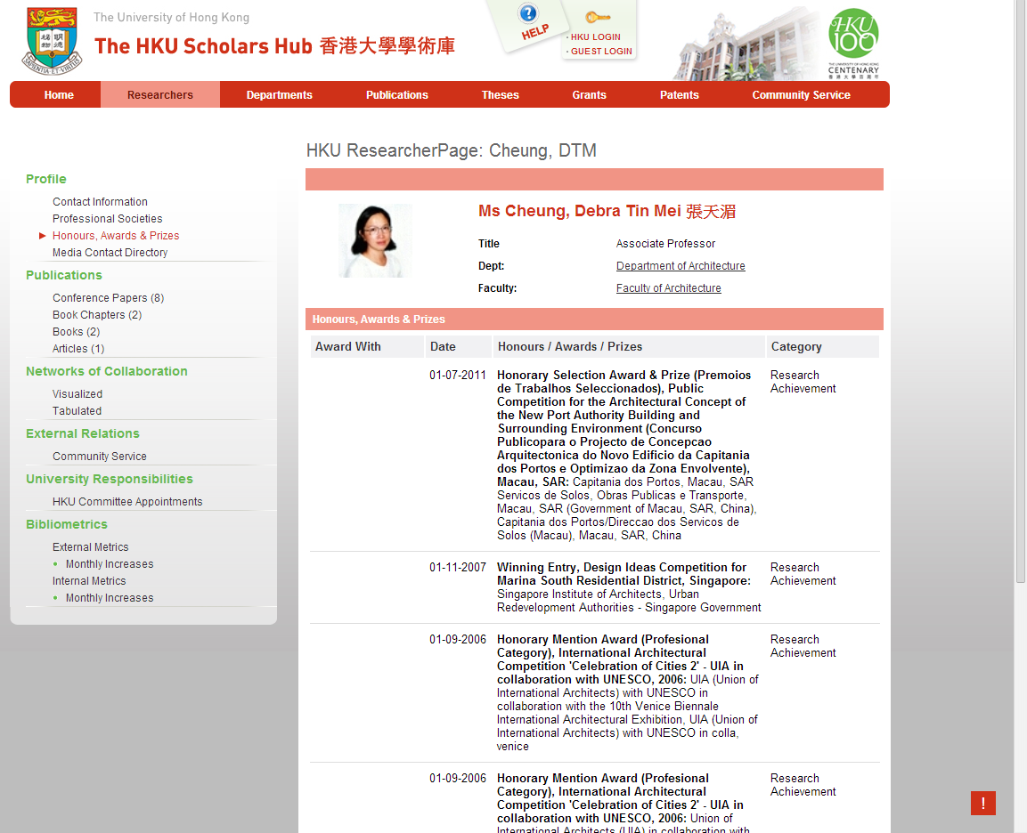
Notes:
Pub data is not so important to architects.
More important are the awards they have won.

Slide 34
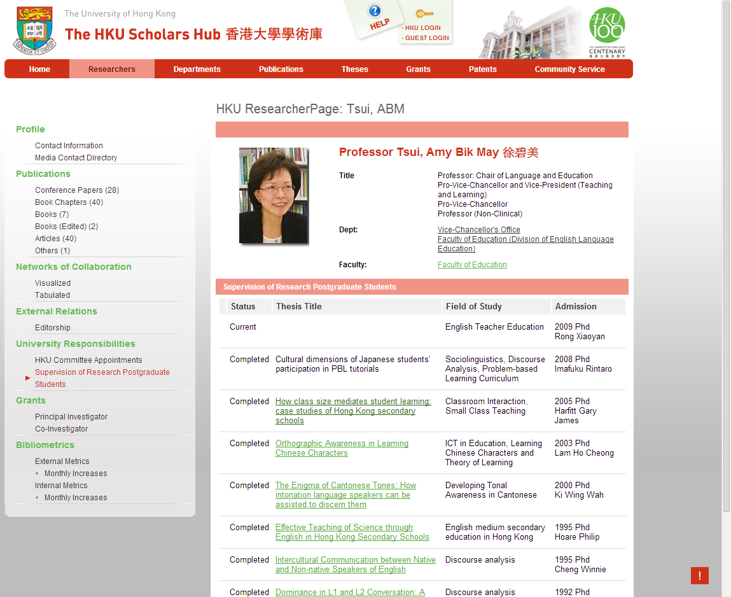
Notes:
This page has links to the fulltext of theses, for those students she supervises.

Slide 35
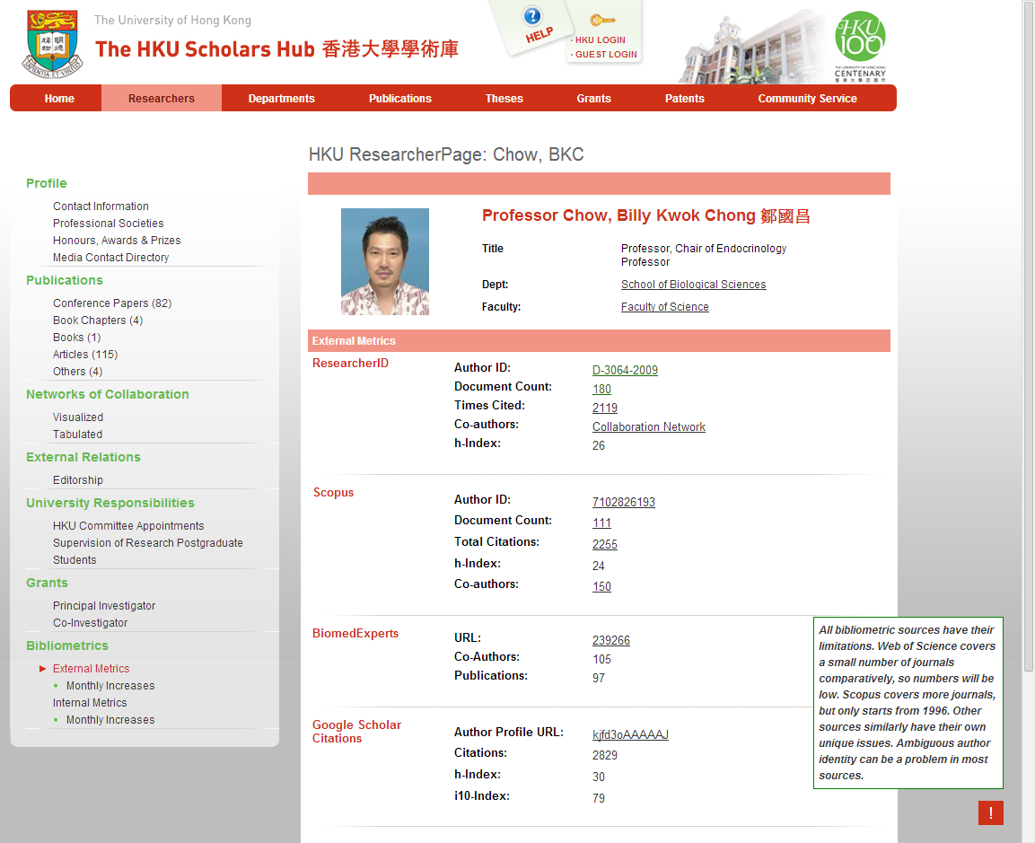
Author Level Metrics
Notes:
This page shows bibliometrics from external sources which we harvest weekly.
Dashboard on impact
Author level metrics

Slide 36
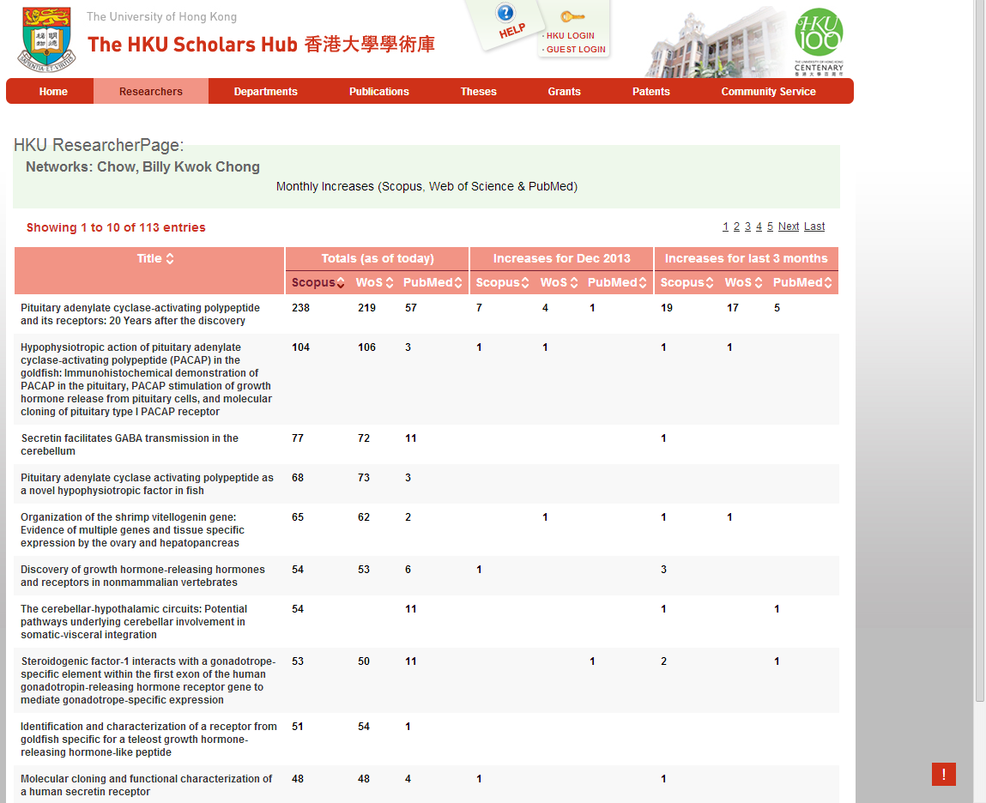

Slide 37
➔外部数据来源
機構 | 數據庫
Elsevier | Scopus
-- 同上 | BiomedExperts
Thomson Reuters | ResearcherID Web of Science
RePEc
SSRN
ACM Digital Library
NIH | PubMed
Google | Google Scholar Citations
Microsoft | MS Academic Search
MathSciNet
CiteULike
將加入: ResearchGate
将加入: ImpactStory

Slide 38
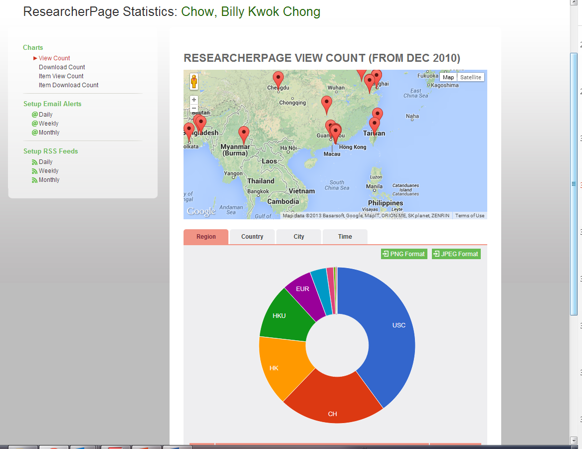
Notes:
This page shows our internal metrics: view counts, download counts, by item, and cumulated to the individual author.

Slide 39
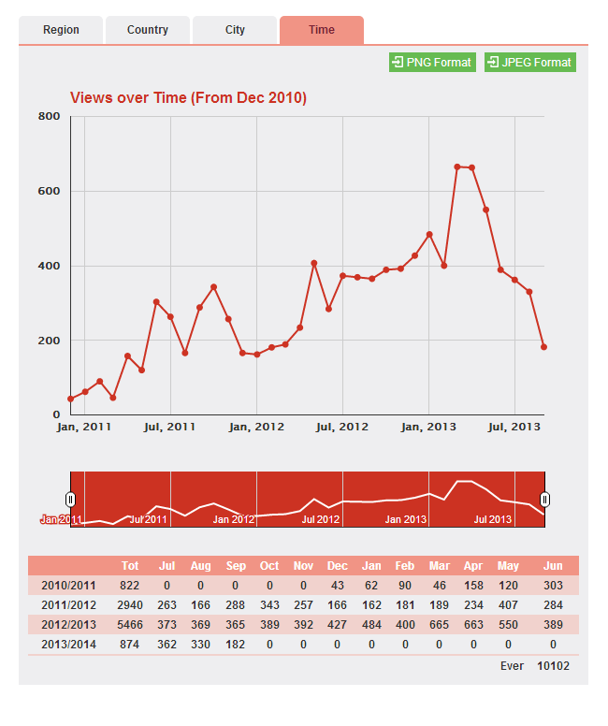
Notes:
Statistics, monthly and annual

Slide 40
Theses & Dissertations
学位论文

Slide 41
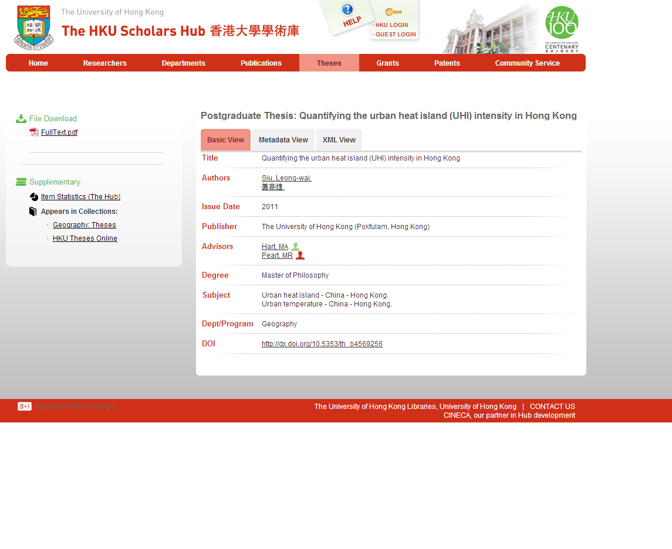
Notes:
Over 20k fulltext theses.
We show advisors for each thesis.
We have also begun to register DOI with CrossRef for each of our theses, to make them highly discoverable.
We expect that DOI will enable us to show more usage statistics.

Slide 42
Grants (Projects)
基金/拨款(项目)

Slide 43
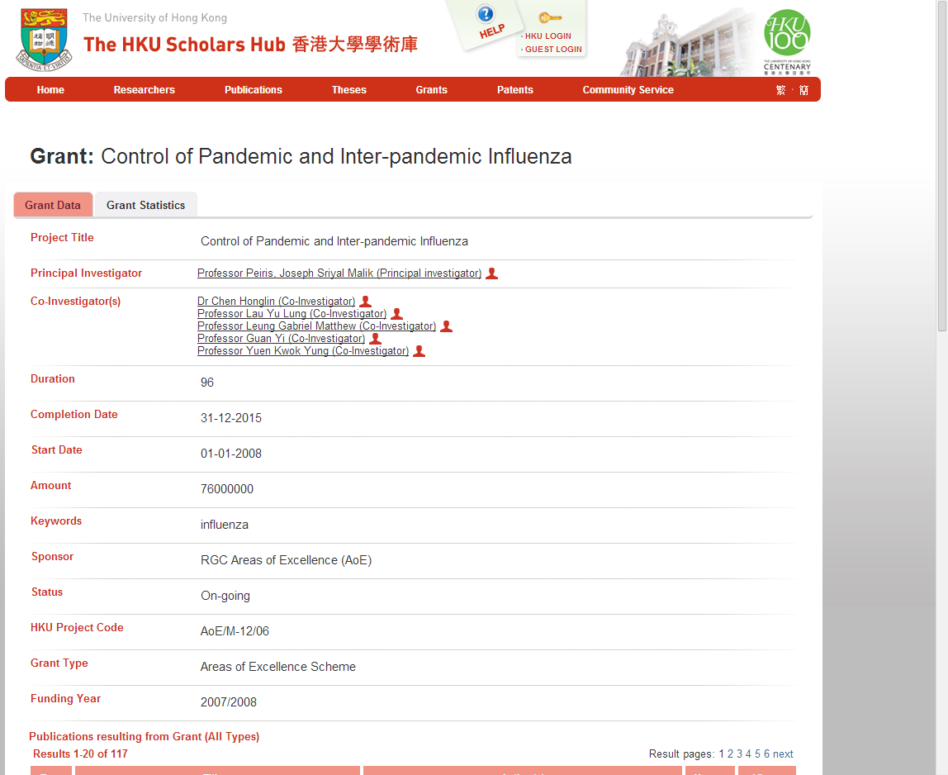
Notes:
We can show and link to PI and CoI for each grant.
Grants can show and link to publications that resulted from the research.
We could also show links to patents that resulted from the research.
Where possible we show additional information about the grant.

Slide 44
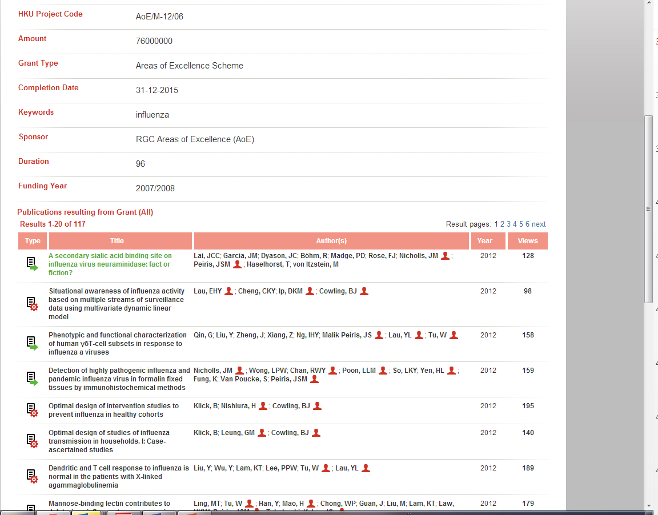

Slide 45
Patents
          专利

Slide 46
➔专利数据来源
国家 | 来源
美国 | USPTO Derwent
世界 | Patent Lens Patentscope Espacenet
美国（化学领域） | SciFinder
欧洲 | European Patent Office(欧洲专利局)
日本 | Japan Patent Office(日本专利局)
中国 | State Intellectual Property office of the PRC(中华人民共和国国家知识产权局)

Slide 47
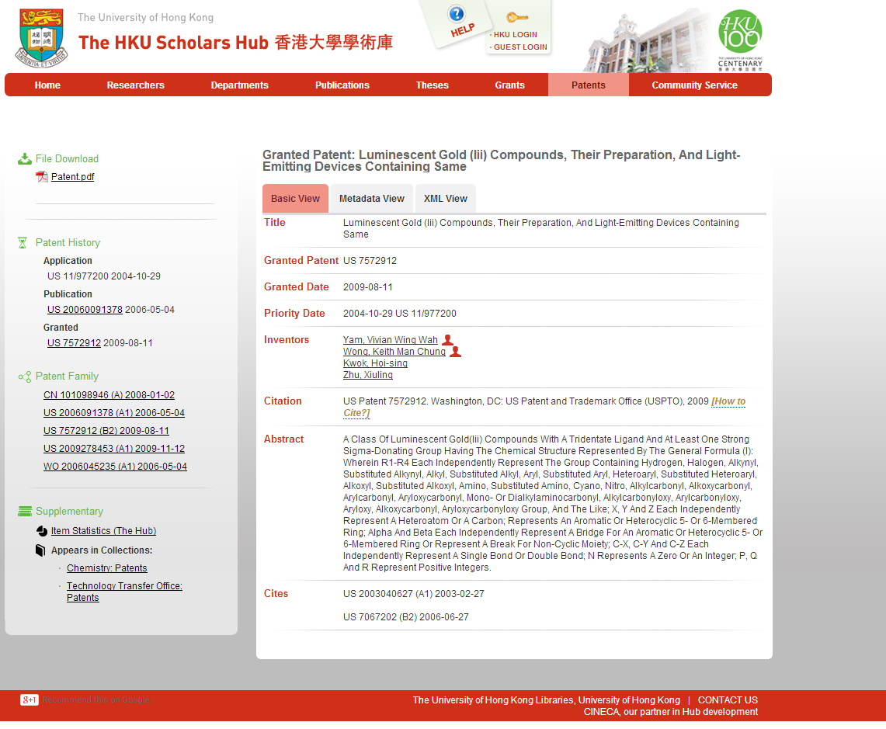
Notes:
One completed or granted patent has 3 dates and numbers each for Application, Publication, and when Granted.
They can also have corresponding patents in other jurisdictions or countries. Together they form a ¨patent family¨.
This patent record may also show other patents it cites, and those which cite this patent.

Slide 48
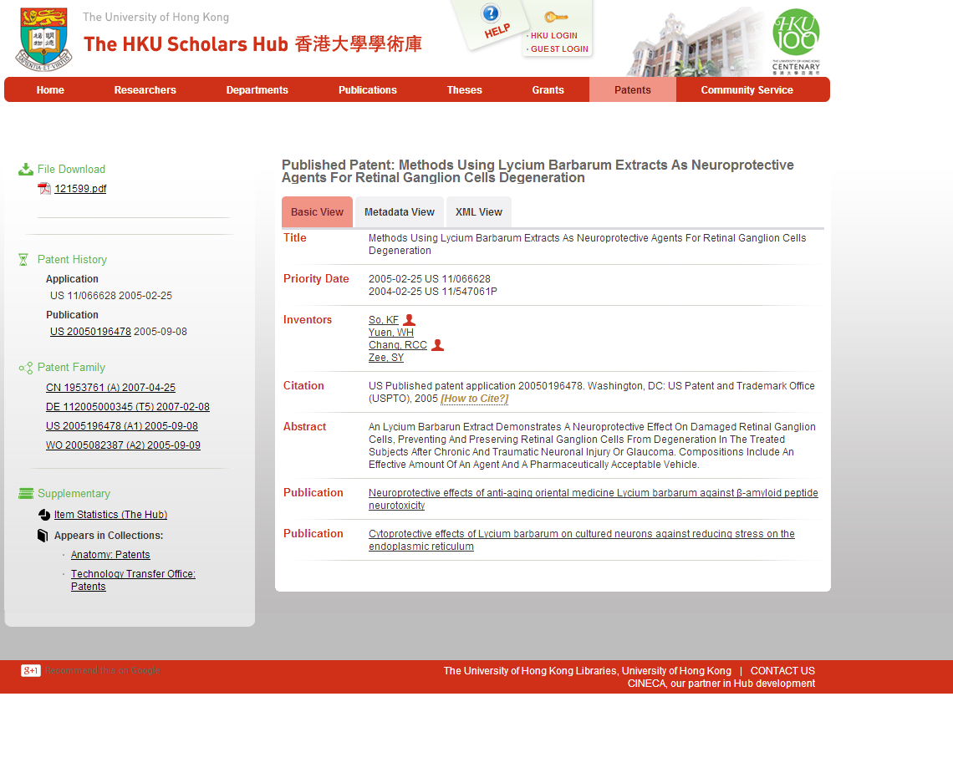
Notes:
This patent record shows a link to a publication written by one of the inventors, about this patent.

Slide 49
Visualizations
形象化的信息呈现

Slide 50
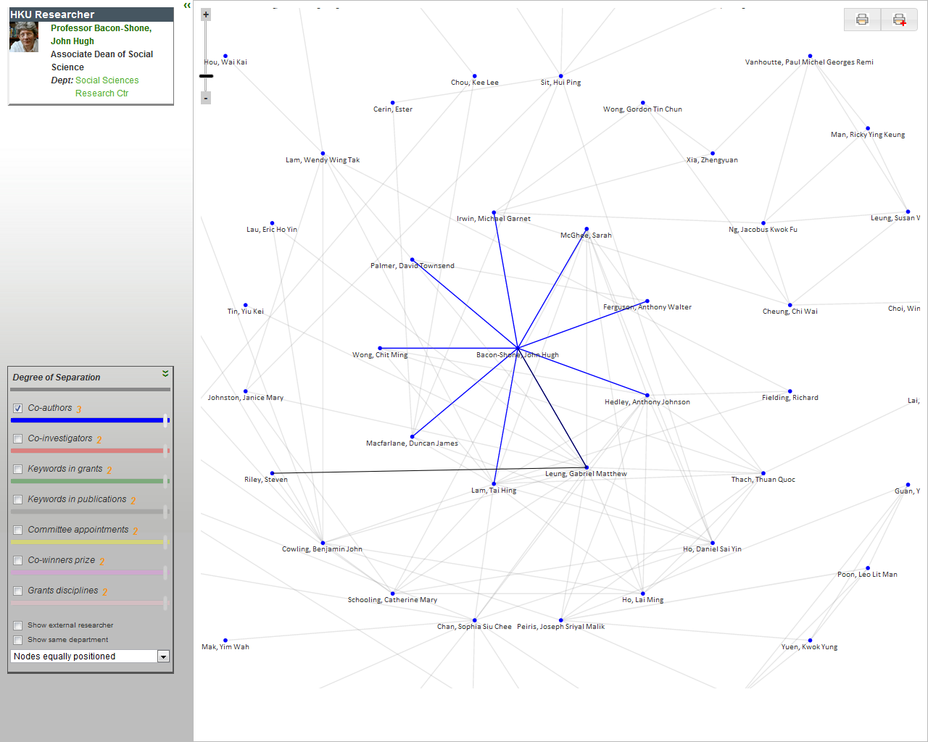
Notes:
We are building visualizations showing how one author or PI is connected to other authors.
The visualizations can show degrees of separation: showing co’authors of coáuthors of the author..

Slide 51
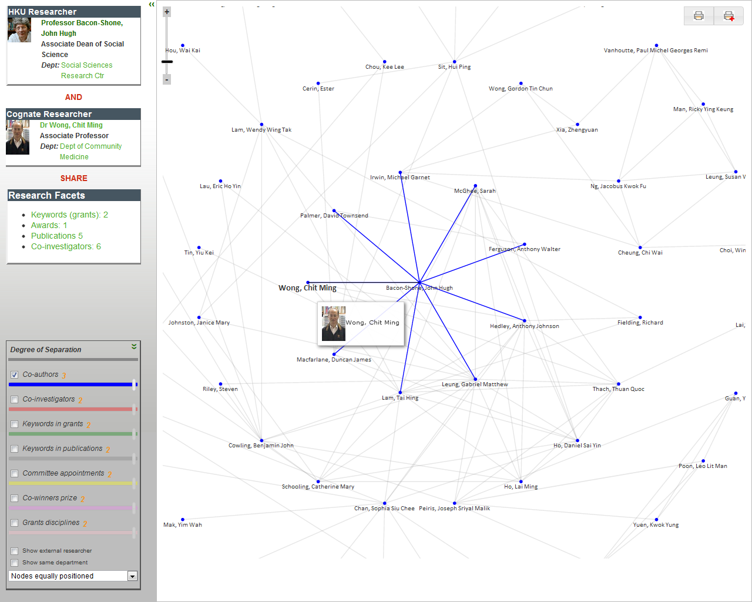
Notes:
When we click on a name in the chart, it goes to the Cognate Box, and shows which facets of research are shared between the two.
Clicking on a facet will then show the actual publication, grant, etc.

Slide 52
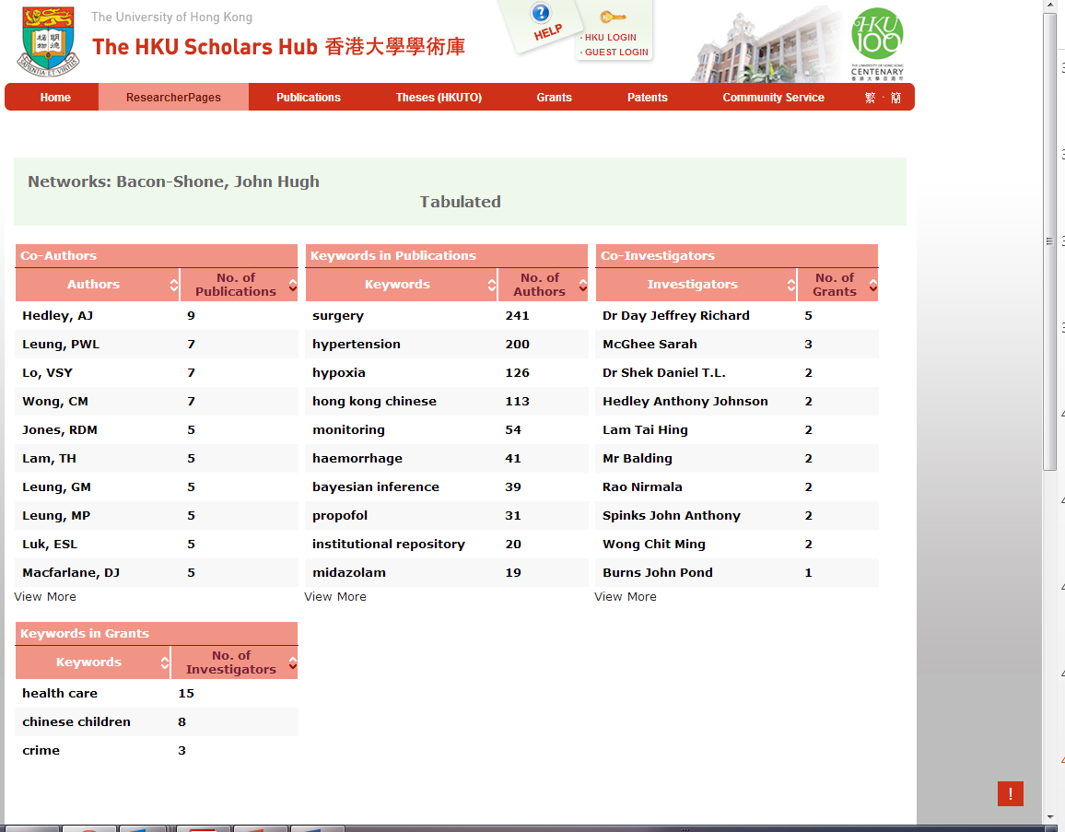

Slide 53
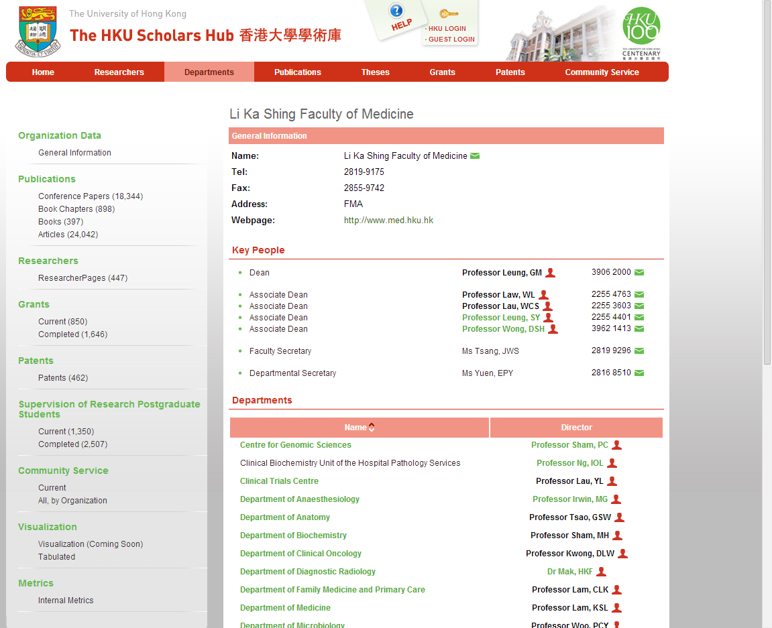

Slide 54

The HKU Scholars Hub (The Hub)
-- A Current Research Information System (CRIS)
HKU Sources
Registry
Research Services
Graduate School
Public Affairs
Tech Transfer
Individual scholars
Individual Depts
Librarians
Collective Intelligence
External Sources
Scopus,
WoS, ResearchID
SSRN
ACM Digital Library
Google Scholar Citations
Etc.

Slide 55
Other KEO Funded Library Projects
OA publishing
ORCID
等々

Slide 56
HKU OA Publishing
2010~12. Springer Open
2013. PLoS
  Institutional Membership
2013~14. Sage Open
Others:
  PNAS
  BioMed Central
2014? UGC Libraries join SCOAP

Slide 57
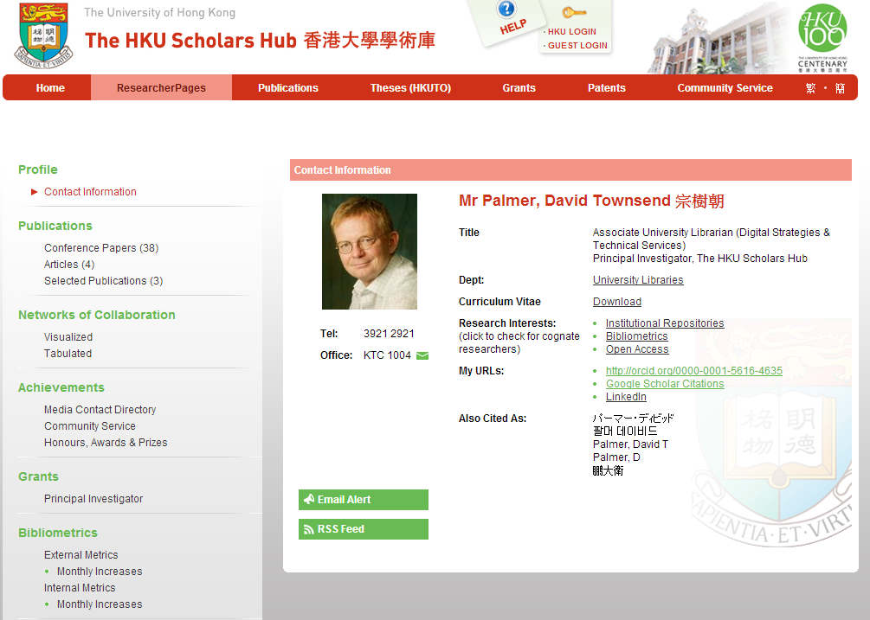
ORCID: Institutional Creation

Slide 58
The Problem:
One Person: many names
  Hong Kong ID card
  Wong, Danny Wai Ming Roman
  黃偉明 Chinese (漢字 - hanzi)
Published or Academic Form
  Wong, WMD
  Wong, WM
  Wong, DW
Pronunciations from other vernaculars:
  Hanyu Pinyin (Mandarin) Huang Weiming
  WadeGiles（Taiwan） Huang Wei-ming
  Fokkien people in Taiwan Hwang, Wai-ming
  Korean: Huang Wim Yeong
Other listings,
  Wong, Danny WM
Notes:
• for researchers: easy access to relevant information and associated software, processor power, storage systems and - where necessary - detectors to collect more data to overcome incomplete or inconsistent information
• for research managers and administrators: easy measurement and analysis of research activity and easy access to comparative information
• for research councils: optimisation of the funding process
• for entrepreneurs and technology transfer organizations: easy retrieval of novel ideas and technology in a knowledge-assisted environment and easy identification of competitors and previously done similar research
• for the media and public: easy access to information, software and computer power to allow easily-assimilated presentation of research results in appropriate contexts.

Slide 59
One name: many people
Academic Name
  Wong, DWM
    Wong, Daniel Wai Ming
    Wong, David Wing Man
From Romanization to Hanzi (漢字)
  Wong, Wai-ming
    黃偉明 (traditional)
    黄伟明 (simplified)
    王偉明
From Hanzi (汉字) to Romanization
  黄偉明
    Wong, Wai-ming (Hong Kong customary)
    Huang, Weiming (Hanyu Pinyin)
    Huang, Wei-ming (Taiwan Wade-Giles)
    Hwang, Wai-ming (Fokkien customary)

Slide 60
Ambiguous identity
Authors
Inventors
Principal / Co-Investigators
Contractors / consultants
Architects
Thesis advisors
等々

Slide 61
The problem incarnate
Personal Reputation
  Lost citations
  Lost opportunities
  Lower measures of esteem
    Peer review
Smaller Institutional digital footprint
  Rankings
  Peer review
  Less funding
  Smaller standing in Unesco country reports
  等々

Slide 62
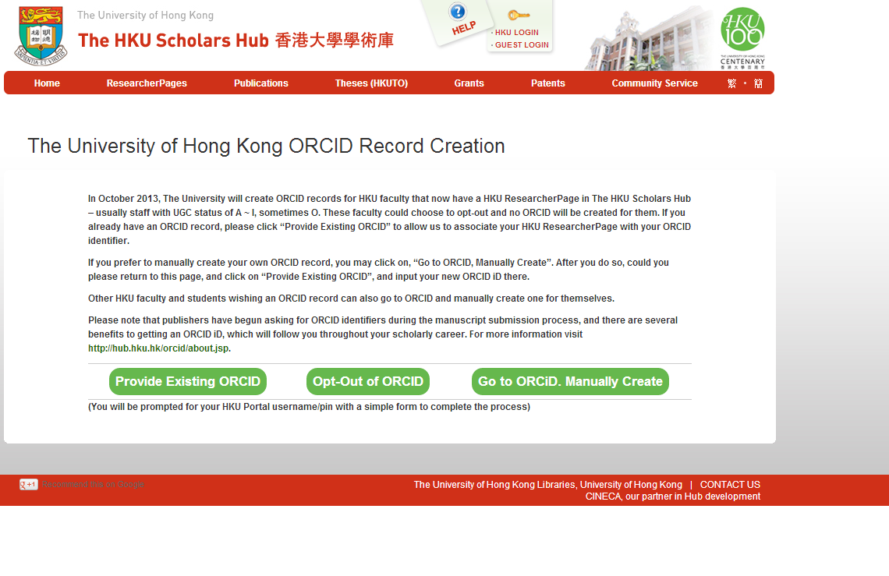

Slide 63
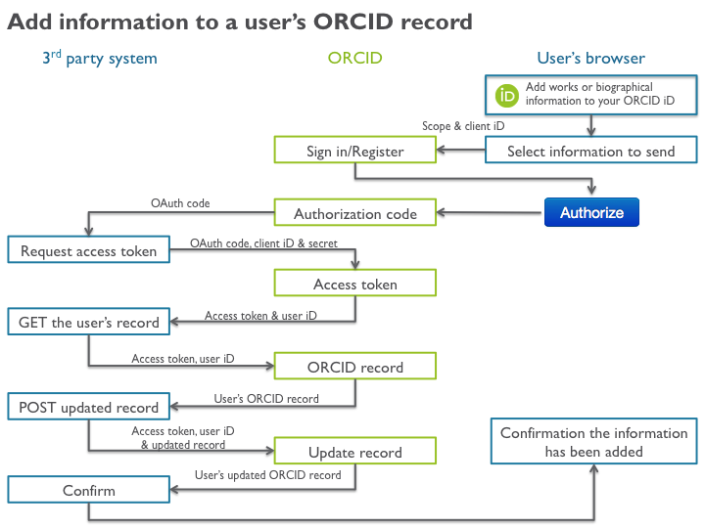

Slide 64
HKU OA: Events & Policies
2000. e-Thesis Mandate
  2005. Retro theses scanned ➔ 22,000+ now online (2014)
  2010. Only e-thesis collected for non-research degrees
2008 Creative Commons, Hong Kong
2009. Berlin Declaration on OA, signatory
2009. HKU KE initiative launched
2010. HKU Libraries OA Policy
2011. Intellectual Property Rights Policy
  [Staff grant the University a non-exclusive licence]
  [Staff shall procure a right from the publisher for the University to repost in the University’s IR]
  HKU ➔ All UGC universities ?
2014?. Policy on Data Management
  HKU ➔ All UGC universities ?

Slide 65
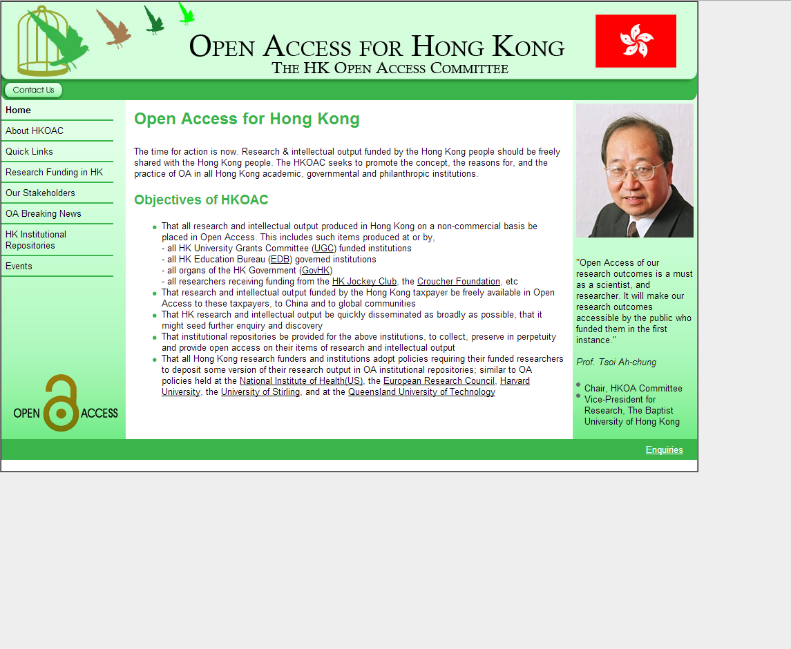

Slide 66
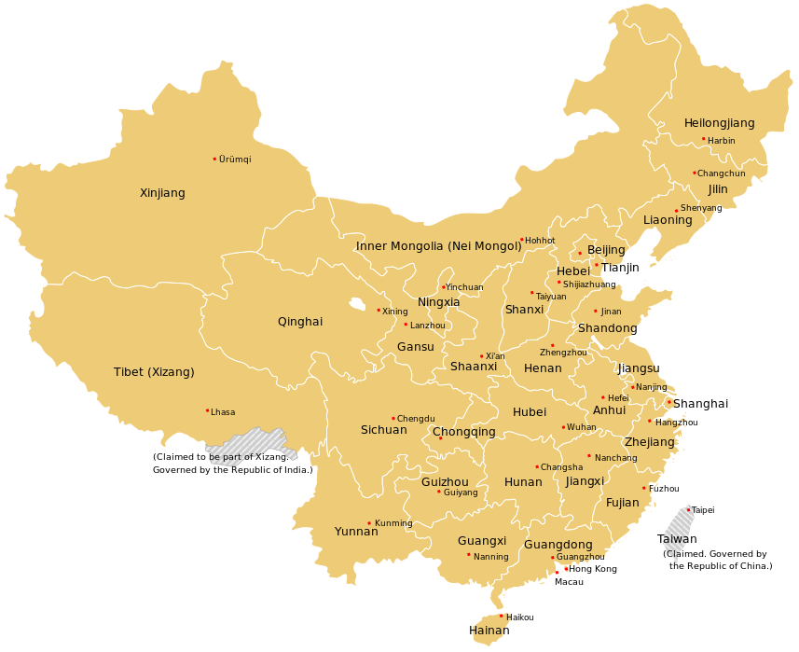
Greater China Survey
IR
OA Mandates
OA Publishing

Slide 67

Hong Kong SAR
HKIR - http://hkir.ust.hk/hkir/
Publication
Items Platform
HKU 144,338 DSpace-CRIS
CUHK 80,252 DSpace
HKUST 63,513 VuFind / DSpace
HK IeD 12,300 DSpace
PolyU 5,755 DSpace
CityU 3,630 DSpace
HKBU 1,113 Digital Commons (BePress)
LU 600 Digital Commons (BePress)
Project of Jsys, sub-committee of JULAC
OAI-PMH
HKIR metadata in Primo

Slide 68
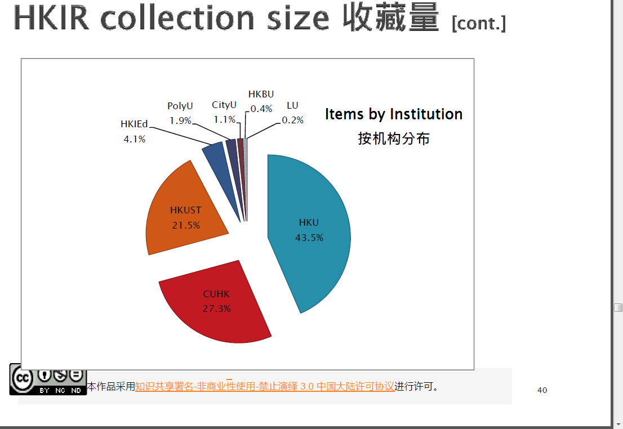

Slide 69
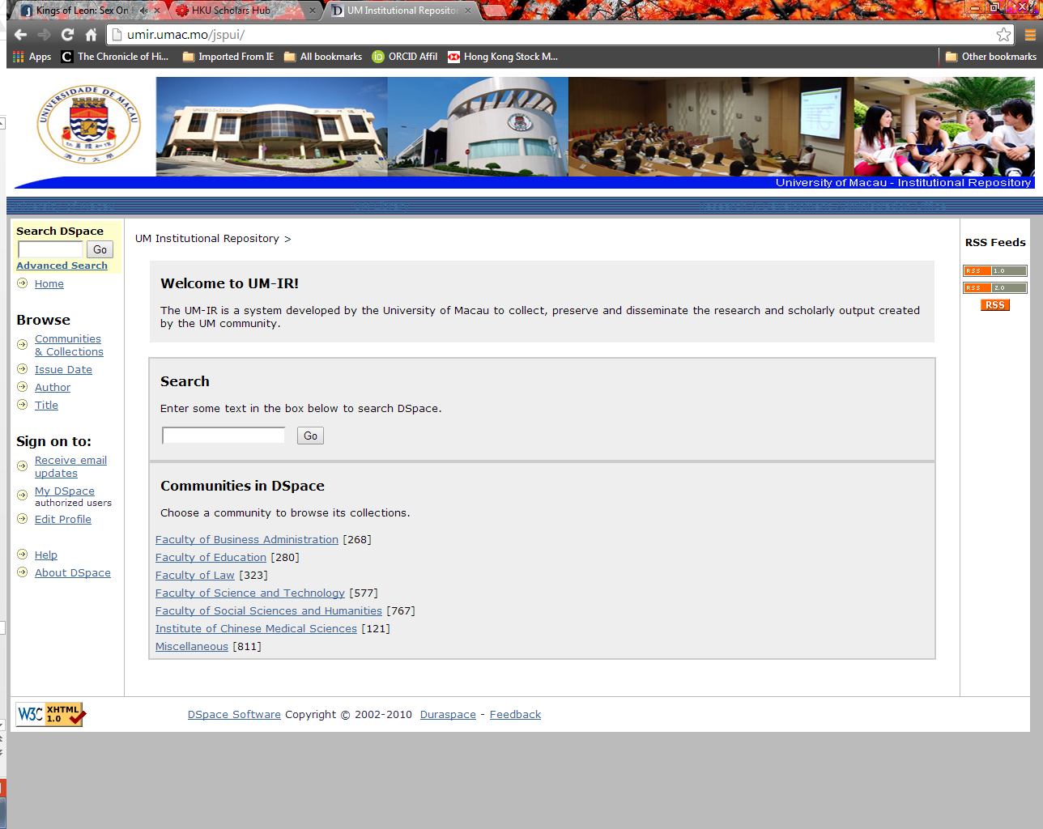

University of Macao
DSpace
3,147 items

Slide 70
Hong Kong SAR & Macao SAR
OA Publishing
  HKU
OA Mandates
  HKU
  PolyU
    2010 ~ “Policy in Support of Open Access to Published Research”

Slide 71
Hong Kong SAR & Macao SAR
OA Publishing
  HKU
OA Mandates
  HKU
  PolyU
    2010 ~ “Policy in Support of Open Access to Published Research”

Slide 72

Taiwan ROC
TAIR - http://tair.org.tw/
臺灣學術機構典藏 (TAIR)
Taiwan Institutional Repository (TAIR)
  Commissioned by Ministry of Education
  Excecuted by National Taiwan University Library
  131 IRs, 1.43M fulltext objects, 100M visits in 2013
  Single search on all
  Many conferences, seminars & workshops

Slide 73
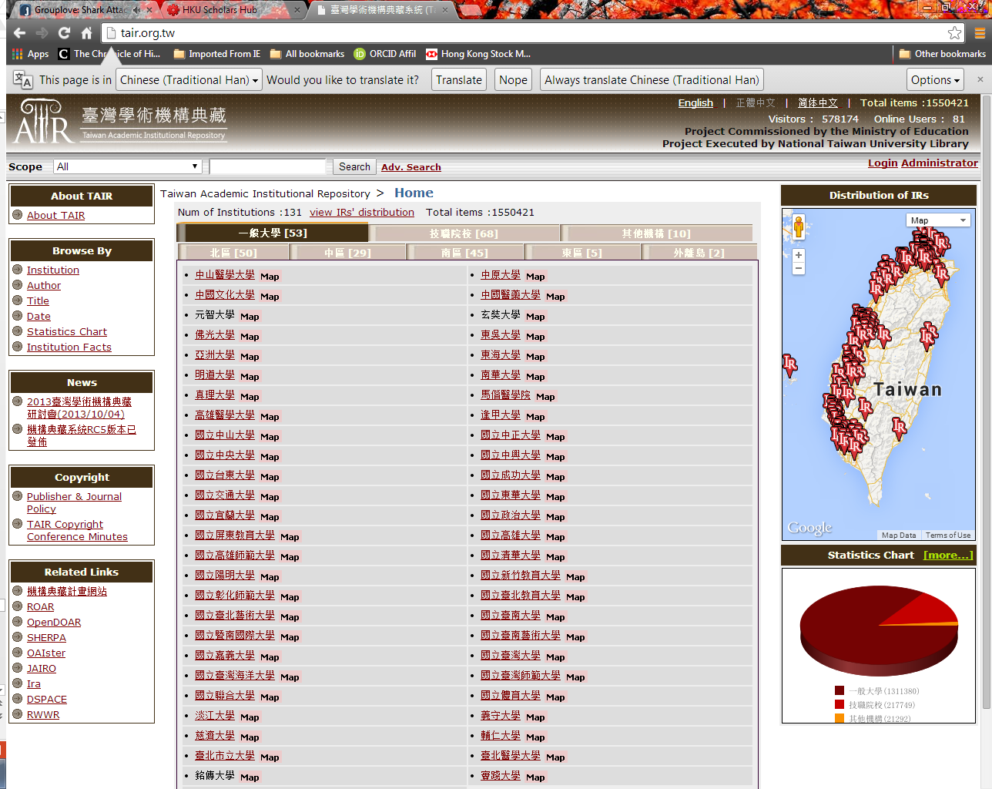

Slide 74
Taiwan ROC
OA Publishing
  ?
OA Mandates
  “No, but a few schools encourage deposit”

Slide 75

China PRC, Events & Policies
2003. Chinese Academy of Sciences (CAS) signs Berlin Declaration
NSFC Natural Science Foundation of China (NSFC) signs Berlin Declaration
Cn.arXiv.org, Chinese mirror site, Institute of Theoretical Physics, CAS
China Open Resources for Education (CORE)
2010. Berlin8 hosted by CAS

Slide 76
China PRC
CHAIR - http://ir.calis.edu.cn/
中国高校机构知识库
25 Major Chinese academic libraries
Commissioned by China Academic Library & Information System (CALIS)
Project Contractor, PKU Library
DSpace 1.8
One search

Slide 77
National Science Library (NSL),
Chinese Academy of Sciences (CAS)
中国科学院国家科学图书馆
2013。机构知识库与科技成果传播利用
张冬荣; 张晓林; 祝忠明

Slide 78
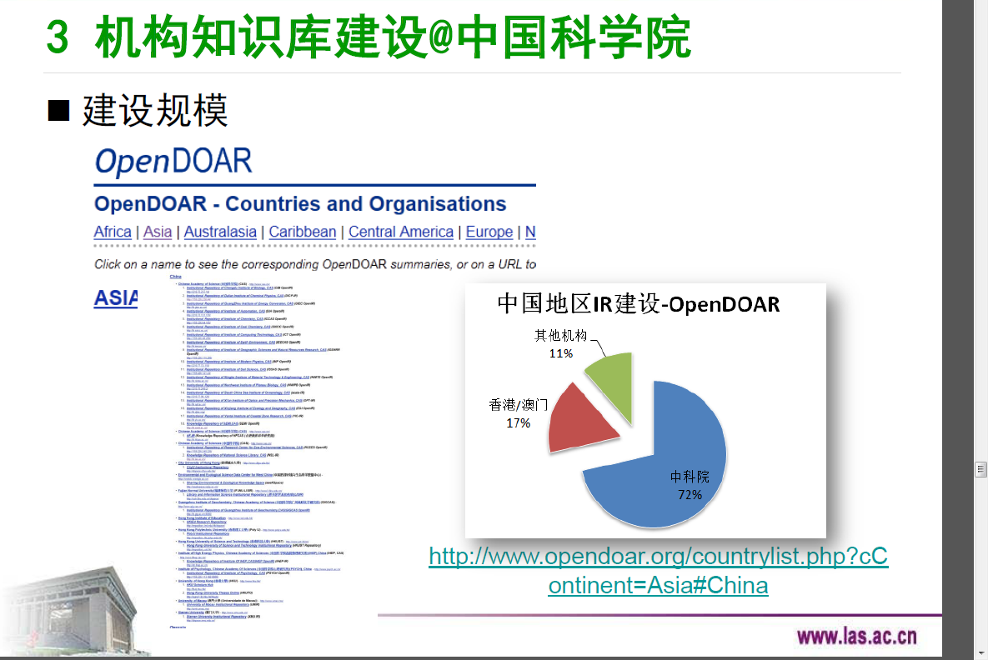
CAS IR Grid: 91 IRs

Slide 79
Chinese Academy of Sciences (CAS)
Open Access Week
2012 ~ . China IR Implementation Group
  中国机构知识库推进专家组
  14 founding members
  China IR Portal
COAR, Confederation of Open Access Repositories
2013. 1st China IR conference, Yunnan

Slide 80
China PRC
OA Publishing
  CAS
    BioMed Central & PLoS Institutional Membership
  CAS & Other Universities
    researchers can use grants to pay APC
OA Mandates
  CAS NSL
  2009. Executive Order. NSL staff & postgraduate students

Slide 81
Directory of OA Journals
UK: 616
USA: 1,214
DOAJ: 9,804
(Jan 2014)

Slide 82
This PPT & PDF are licensed under the Creative Commons Attribution “CC-BY” license. This license permits use of this work, so long as attribution is given. For more information about the license, visit
http://creativecommons.org/licenses/by/3.0/
Archived at,
http://hub.hku.hk/handle/10722/194052
David T Palmer
http://hub.hku.hk/cris/rp/rp00001
http://orcid.org/0000-0001-5616-4635

